Slide 1

19AIE113-Introduction to Electronics
PROJECT: IMPLEMENTING NAND GATE USING TRANSISTORS

Slide 2
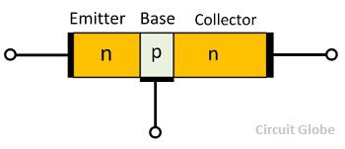
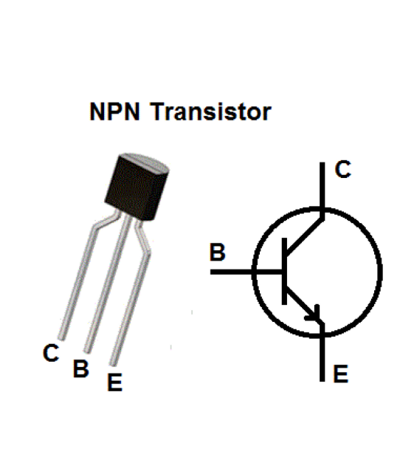
NPN TRANSISTOR
A transistor is a semiconductor device used to amplify or switch electronic signals and electrical power.

Slide 3
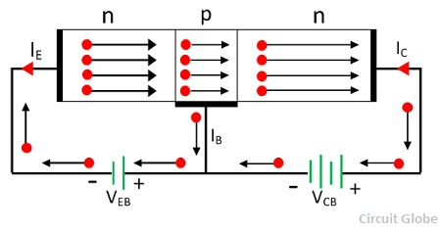
NPN transistor is one of the Bipolar Junction Transistor (BJT) types. The NPN transistor consists of two n-type semiconductor materials and they are separated by a thin layer of p-type semiconductor.
Here the majority charge carriers are the electrons. The flowing of these electrons from emitter to collector forms the current flow in the transistor.
Generally the NPN transistor is the most used type of bipolar transistors because the mobility of electrons is higher than the mobility of holes.
The NPN transistor has three terminals – emitter, base and collector. The NPN transistor is mostly used for amplifying and switching the signals.

Slide 4
TRANSISTOR AS A SWITCH
A transistor is used for switching operation for opening or closing of a circuit. This type solid state switching offers significant reliability and lower cost as compared with conventional relays.
Based on the voltage applied at the base terminal of a transistor switching operation is performed.
Transistor has three operating regions namely Active region , cutoff region & Saturation region which are classified based on their biasing conditions and transistor works as a Switch when operated in Cutoff and Saturation Regions.

Slide 5
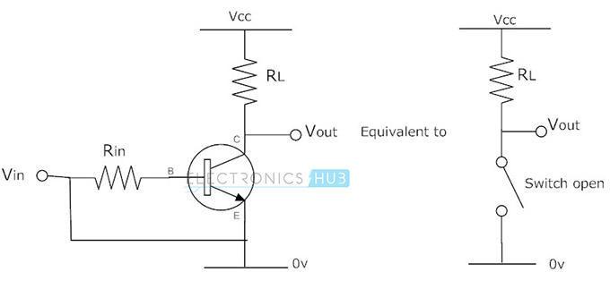
Cutoff Mode
In this mode, both collector base junction and emitter base junction are reverse biased. This in turn not allows the current to flow from collector to emitter when the base-emitter voltage is low. In this mode device is completely switched off as the result the current flowing through the device is zero.

Slide 6
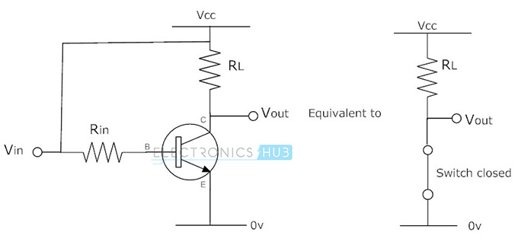
Saturation Mode
In this mode of operation, both the emitter base and collector base junctions are forward biased. Current flows freely from collector to emitter when the base-emitter voltage is high. In this mode device is fully switched ON.

Slide 7
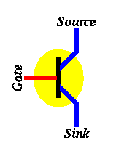
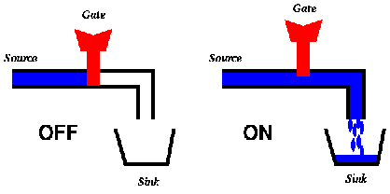
VISUALIZING TRANSISTOR AS SWITCH

Slide 8
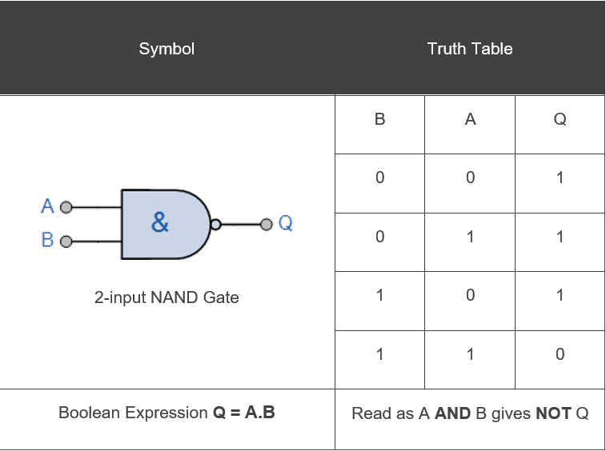
NAND GATE

Slide 9
IMPLEMENTING NAND GATE USING TRANSISTORS
The use of transistors for the construction of logic gates depends upon their utility as fast switches.
When the base-emitter diode is turned on enough to be driven into saturation, the collector voltage with respect to the emitter may be near zero and can be used to construct gates for the TTL logic family.
For the NAND logic, the transistors are in series, but the output is above them. The output is high unless both A and B inputs are high, in which case the output is taken down close to ground potential.

Slide 10
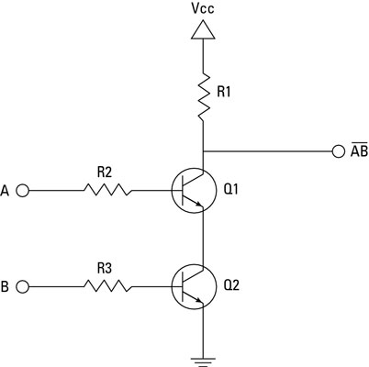
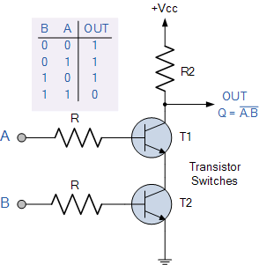
CIRCUIT DIAGRAM

Slide 11
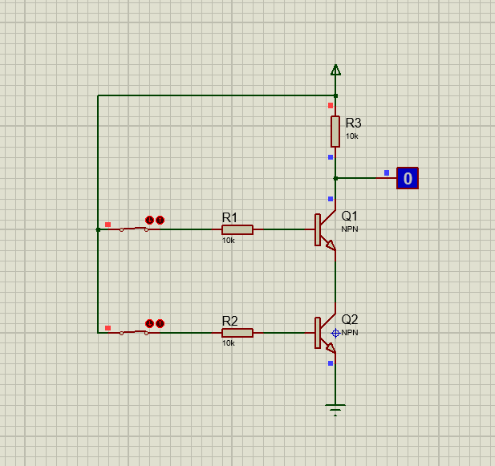
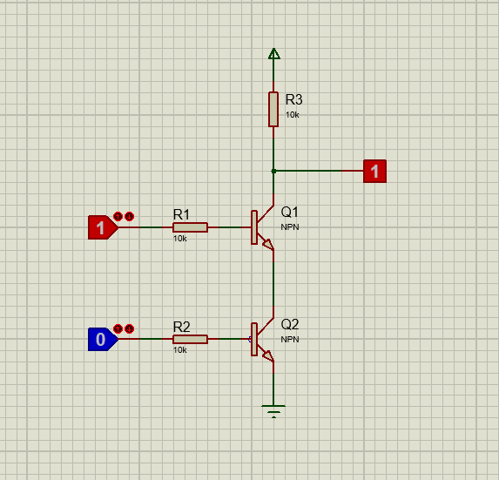
IMPLEMENTATION

Slide 12
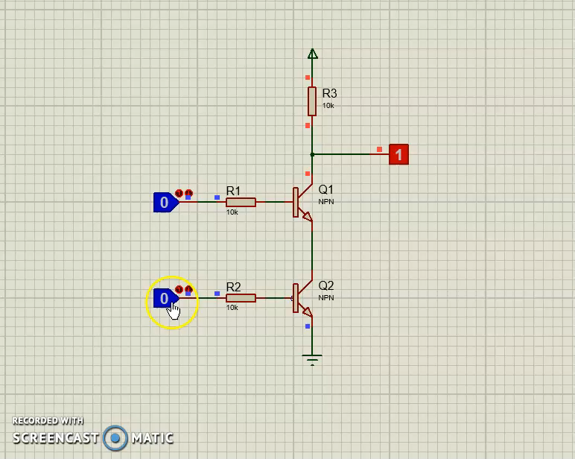

Slide 13
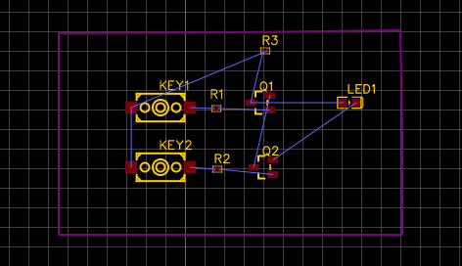
PCB IMPLEMENTATION

Slide 14
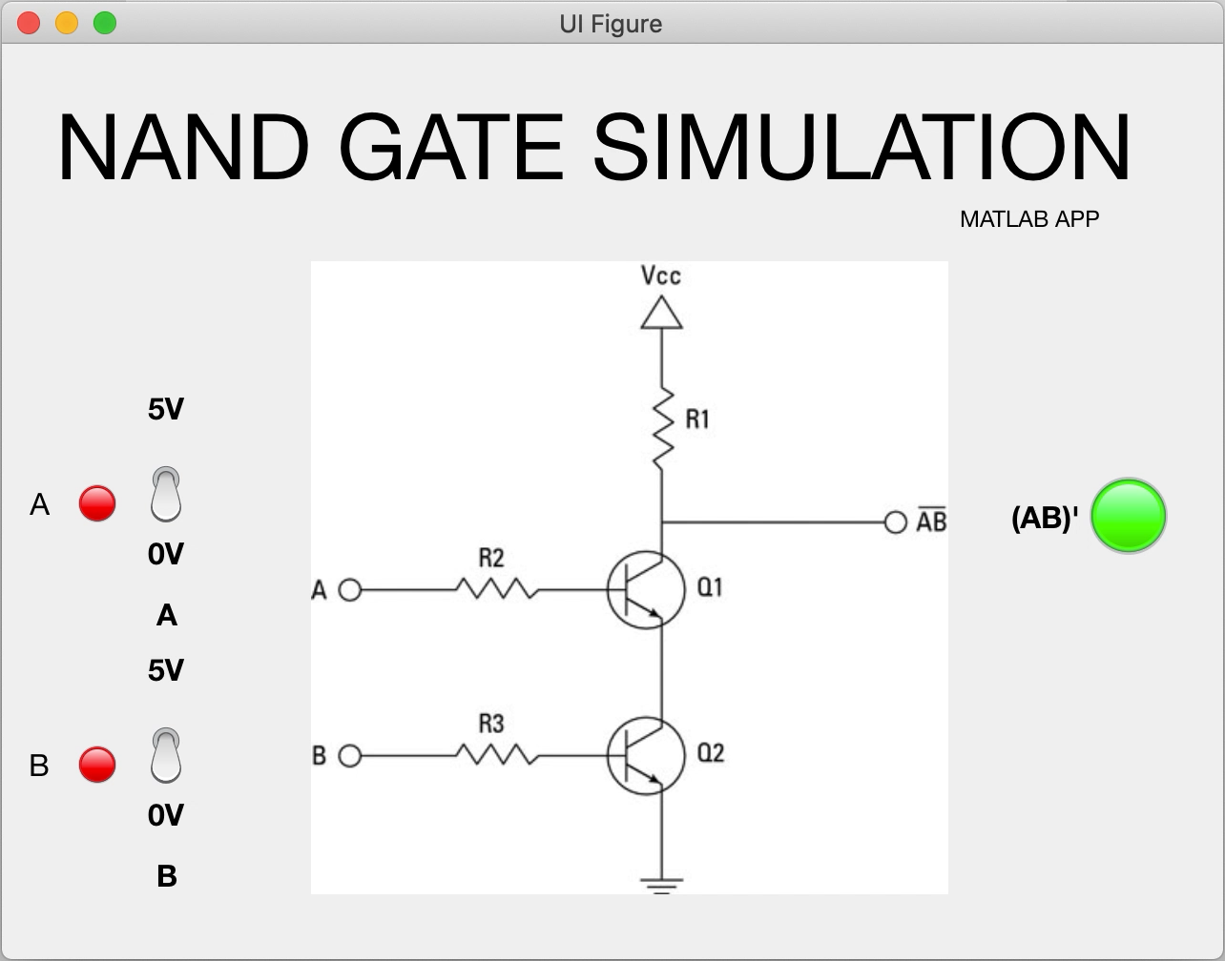
MATLAB APP

Slide 15
THANK YOU
Dinesh S CB.EN.U4AIE19025
Harish K CB.EN.U4AIE19029
Kabilan N CB.EN.U4AIE19033
Sivamaran M.A.C CB.EN.U4AIE19061
Roshan Tushar S CB.EN.U4AIE19071

